Slide 1
Weekly plan for a family of 5
Annika Alt

Slide 2
Project Description
We are a family of 5
My husband Mattias (42 years old), my first son Maximilian (7 years old) my twins Johanna and Vincent (4 years old) and me Annika(36 years old)
With this project, I want to check if we can prepare a weekly plan, which improves our everyday familiy life
I also want to check, if we can use the time on a better way and get more „Me-time“ to make it more relaxed for all of us
The third thing I want to check is, do we get enough time all together as familiy
I collect the data like when is who at work, in school, to his/her hobby, importent appointments, free time, etc.)

Slide 3
Ask
Can we improve our everyday family life
Do we have enough time all toghether?
What can we change, to get more Me-time? (parents)

Slide 4
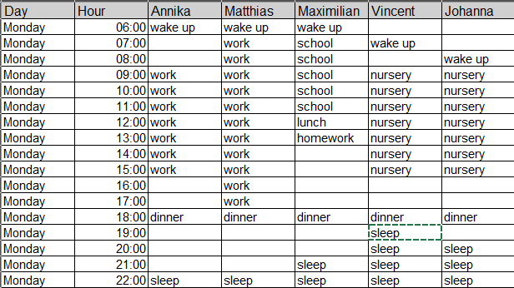
Prepare
Collect the following Data:
Day, time (hourly), who, what

Slide 5
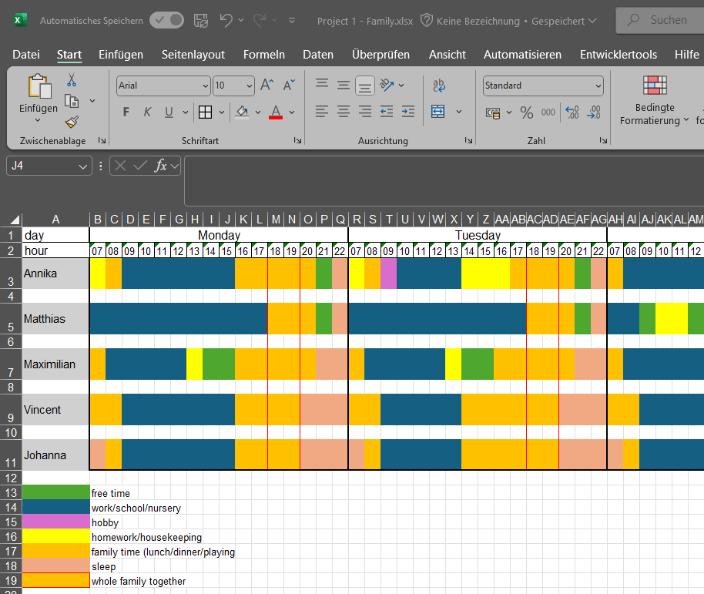
Prepared the data in a weekly plan with diffrent colours for different rubrics

Slide 6
Process
Data collected in a table in Excel
Decide which data is relevant and which not
Summarize it for time at work/school or sleep

Slide 7
Analyze
Created a table for the weekly plan (Monday – Friday)
Created a pie chart for every family member

Slide 8
Charts

Slide 9
Share
Creating a Power Point presentation
Results / Answers / Act
Our every day family life is very balanced and I especially like the role reversal on Wednesdays
On Monday, Tuesday, Thursday and Friday we only have two hours per day as whole family (including dinner and get ready to bed for the children and also watching TV for the kids)
Our every day life is very tightly scheduled For couple time or me-time we have to ask the grandparents for help and plan this on the weekend

Slide 10
Thank you for your attention

